Slide 1
Computer Hardware Store Management System
MINI PROJECT
Department of MCA, MES College of Engineering , Kuttippuram
27th SEPTEMBER 2023
PREPARED BY
ATHULYA MC (MES22MCA-2011)
26/10/23 1

Slide 2
GUIDED BY
Prof.Balachandran K P
ASSOCIATE PROFESSOR
MASTER OF COMPUTER APPLICATIONS
MES COLLEGE OF ENGINEERING , KUTTIPPURAM
26/10/23 2

Slide 3
Introduction
Modules
Data Flow Diagram
Product Backlog
Project Plan
Sprint
Developing Environment
Content
26/10/23 3

Slide 4
INTRODUCTION
The project “COMPUTER HARDWARE STORE MANAGEMENT SYSTEM” consisting an efficient hardware inventory management system. This system is a web project used to manage a stock of various hardware products in the backend and users may buy it online. The store consists of various computer hardware categories including hard-disks, monitors, Disk drives, keyboard, mouse and other various hardware products. Users may browse for various categories and brands of computer hardware. Then they may select desired products and buy it. User can filter products with same specifications and different brands with price scale of minimum and maximum prices.
26/10/23 4

Slide 5
MODULES
1)ADMIN
Login.
Verify Hardwareshops
View complaints and replies based on hardware shops.
View feedback and ratings.
Add notifications.
Add category.
Block or Unblock shops.
2)Hardware shops
Register
Login and update profile.
Manage and add products based on category.
View orders and update status.
View complaints and send replies.
View feedback and replies.
View notifications from admin.
Send offer notifications.
View payment history.
Add and manage purchase
26/10/23 5

Slide 6
3)User
Registration.
Login
View and Update profile.
Search for shops.
View products.
Order and payment.
Order status.
View offer notifications.
Send complaints to hardware shops and view reply.
Send feedback and ratings.
Add and manage cart
26/10/23 6

Slide 7
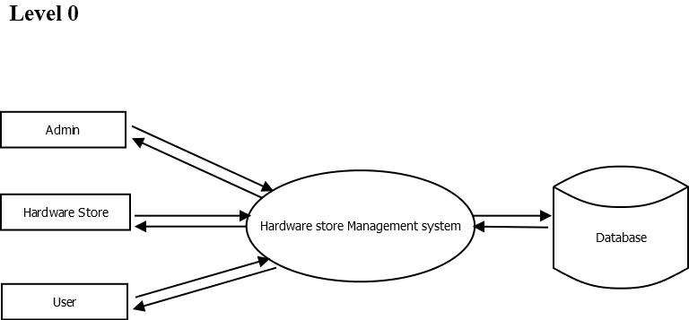
DATA FLOW DIAGRAM
Request
Response
Request
Request
Response
Response
Request
Response
26/10/23 7

Slide 8
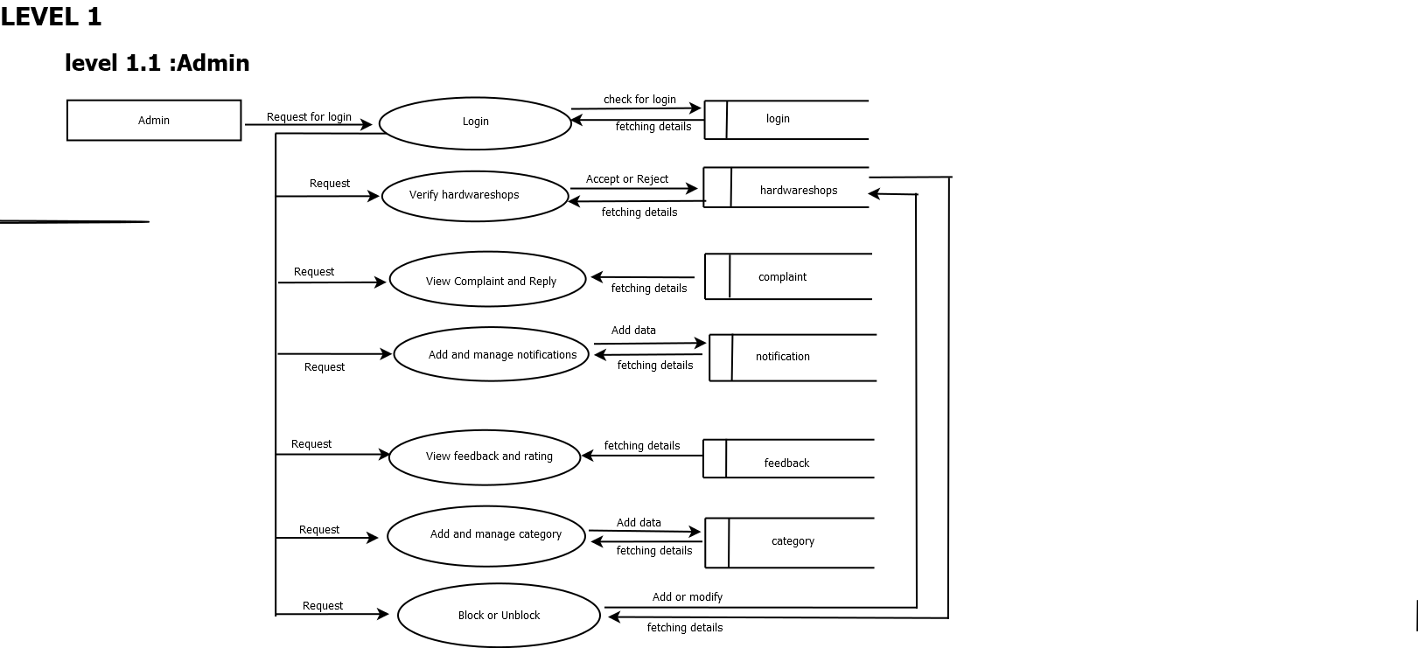
26/10/23 8

Slide 9
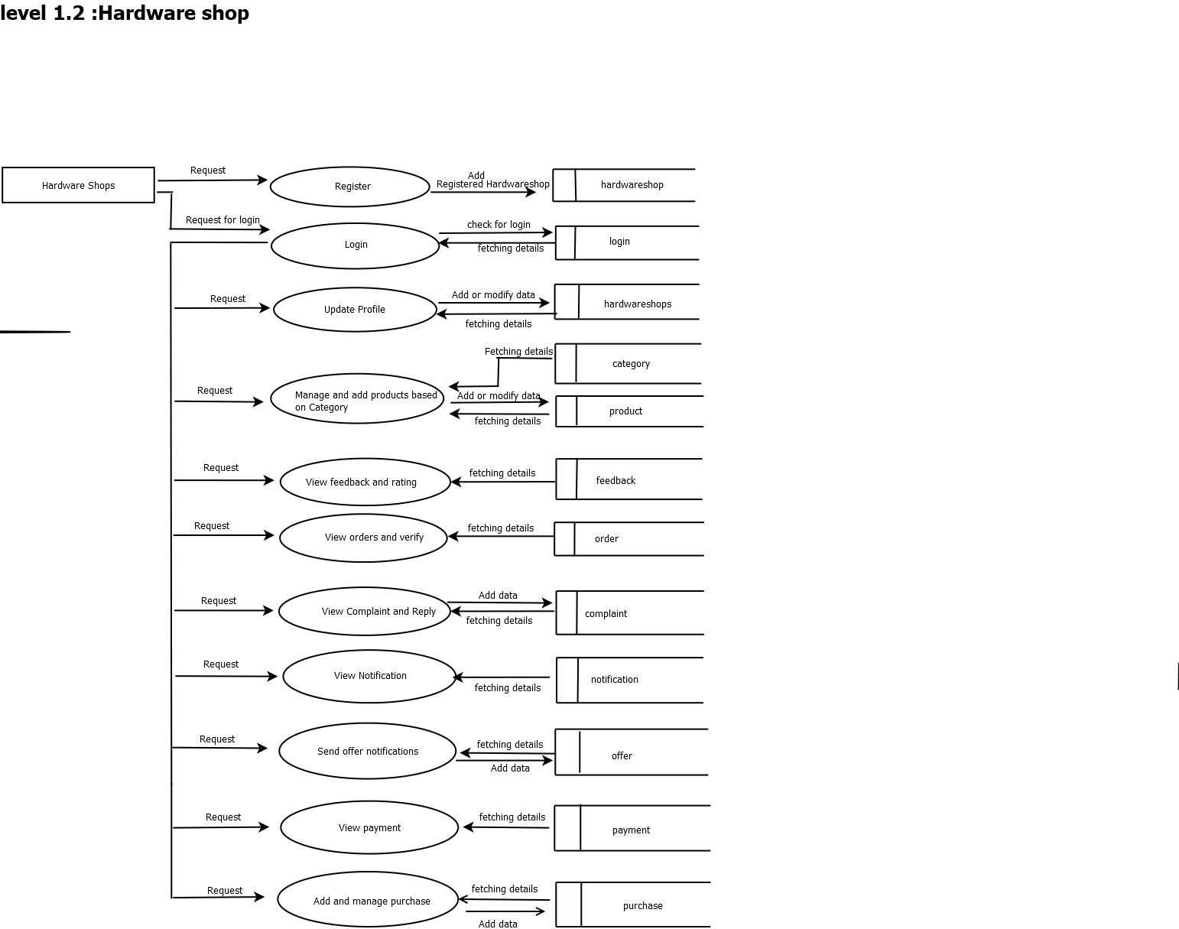
26/10/23 9

Slide 10
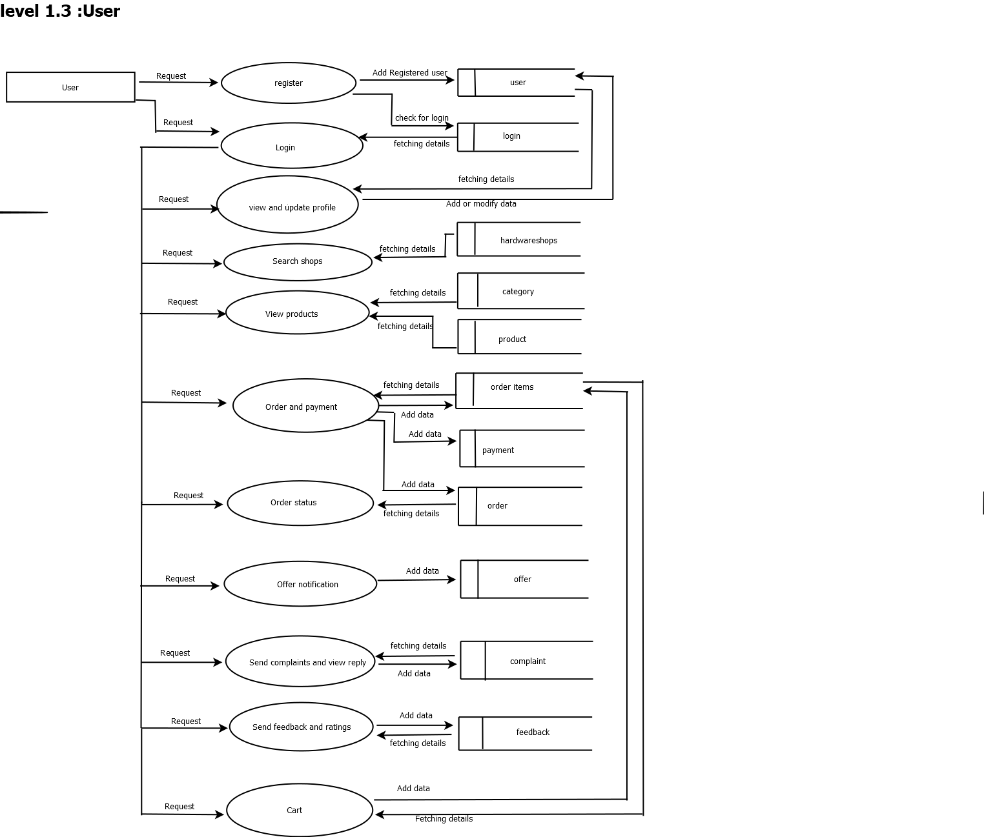
26/10/23 10

Slide 11
PRODUCT BACKLOG
ID | PRIORITY | SIZE (Hours) | SPRINT | STATUS | NAME
1 | Medium | 5 | 1 | Progressing | Registration
2 | Medium | 5 |  | Progressing | Login
3 | High | 10 | 2 | Planned | Table Design
4 | High | 15 |  | Planned | Coding
5 | Medium | 10 | 3 | Planned | Testing data
6 | High | 5 |  | Planned | Output generation
26/10/23 11

Slide 12
PROJECT PLAN
ID | Sprint | Start Date | End Date | Day | Status
1 | Sprint1 | 15/09/2023 | 12/10/2023 | 13 | Planned
2 | Sprint2 | 13/10/2023 | 03/11/2023 | 15 | Planned
3 | Sprint3 | 08/11/2023 | 30/11/2023 | 15 | Planned
26/10/23 12

Slide 13
SPRINT PLAN 1
Backlog Item | Com-pletion Date | Original Estimat-e | Day 1 15/09 | Day 2 20/09 | Day3 21/09 | Day 4 28/09 | Day 5 29/09 | Day 6 04/10 | Day7 05/10 | Day 8 06/10 | Day 9 11/10 | Day10 12/10
 |  | HRS | HRS | HRS | HRS | HRS | HRS | HRS | HRS | HRS | HRS | HRS
Form Design | 15/09 | 2 | 2 | 0 | 0 | 0 | 0 | 0 | 0 | 0 | 0 | 0
Table Design | 28/09 | 3 | 0 | 1 | 1 | 1 | 0 | 0 | 0 | 0 | 0 | 0
Coding | 06/10 | 6 | 0 | 0 | 0 | 0 | 2 | 1 | 1 | 2 | 0 | 0
Testing & validation | 12/10 | 2 | 0 | 0 | 0 | 0 | 0 | 0 | 0 | 0 | 1 | 1
Total |  | 13 | 2 | 1 | 1 | 1 | 2 | 1 | 1 | 2 | 1 | 1
26/10/23 13

Slide 14
Backlog Item | Compl-etion Date | Original Estimate | Day 1 13/10 | Day 2 18/10 | Day 3 19/10 | Day 4 20/10 | Day 5 25/10 | Day 6 26/10 | Day 7 27/10 | Day 8 01/11 | Day 9 02/11 | Day 10 03/11 | Day 11 08/11
 |  | HRS | HRS | HRS | HRS | HRS | HRS | HRS | HRS | HRS | HRS | HRS | HR S
Form Design | 13/10 | 2 | 2 | 0 | 0 | 0 | 0 | 0 | 0 | 0 | 0 | 0 | 0
Table Design | 18/10 | 1 | 0 | 1 | 0 | 0 | 0 | 0 | 0 | 0 | 0 | 0 | 0
Coding | 01/11 | 9 | 0 | 0 | 1 | 2 | 1 | 1 | 2 | 1 | 1 | 0 | 0
Testing &validation | 03/11 | 3 | 0 | 0 | 0 | 0 | 0 | 0 | 0 | 0 | 0 | 2 | 1
Total |  | 15 | 2 | 1 | 1 | 2 | 1 | 1 | 2 | 1 | 1 | 2 | 1
SPRINT PLAN 2
26/10/23 14

Slide 15
SPRINT PLAN 3
Backlog Item | Compl-etion Date | Original Estimate | Day 1 08/11 | Day 2 09/11 | Day 3 10/11 | Day 4 15/11 | Day 5 16/11 | Day 6 17/11 | Day 7 22/11 | Day 8 23/11 | Day 9 24/11 | Day 10 29/11 | Day 11 30/11
 |  | HRS | HRS | HRS | HRS | HRS | HRS | HRS | HRS | HRS | HRS | HRS | HRS
Coding | 22/11 | 10 | 1 | 2 | 1 | 1 | 2 | 1 | 1 | 1 | 0 | 0 | 0
Testing & validation | 30/11 | 5 | 0 | 0 | 0 | 0 | 0 | 0 | 0 | 1 | 1 | 1 | 2
Total |  | 15 | 1 | 2 | 1 | 1 | 2 | 1 | 1 | 2 | 1 | 1 | 2
26/10/23 15

Slide 16
DEVELOPMENT ENVIRONMENT
SOFTWARE SPECIFICATION
Operating System
Frond End
Coding language
Framework
Backend
IDE
Browser
: Windows 8 or above
: HTML,CSS ,Javascript,Bootstrap
:Python
:Django
:MySQL
: PyCharm
:Internet Explorer / Chrome / FireFox
HARDWARE SPECIFICATION
Processor
RAM
: i3 or above
:4GB or Above
26/10/23 16

Slide 17
THANK YOU

